Slide 1
LECTURE 3

Slide 2

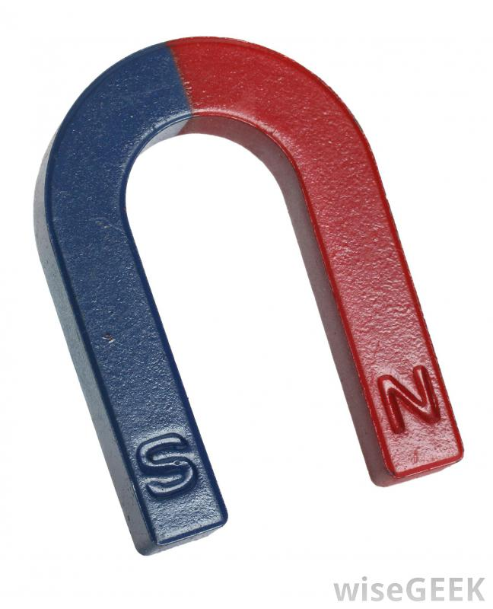
Force acting on a current carrying conductor placed in magnetic field
B
C
A
D
Motion
R₁
R₂
B₁
B₂
+
–

Slide 3


Experiment to observe force experience by a current carrying conductor
S
Magnetic field
Motion is outward
N
Motion is inward
B
C
A
Current is upward
Current is downward

Slide 4

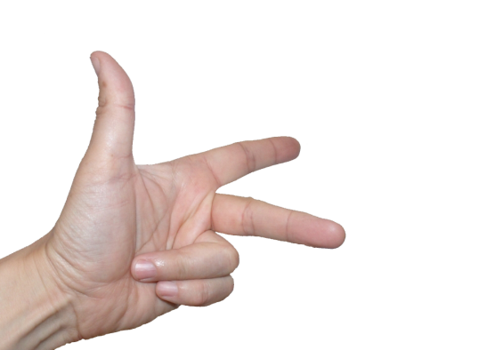
Fleming’s Left Hand Rule
Stretch the thumb, the forefinger and the middle finger of the left hand in such a way that they are perpendicular to each other.
Force on the conductor
Thumb
If,
forefinger is in the direction of the magnetic field,
middle finger is in the direction of the current
then the thumb shows the direction of the force on the conductor.
Forefinger
Direction of the magnetic field
Middle finger
Direction of current

Slide 5

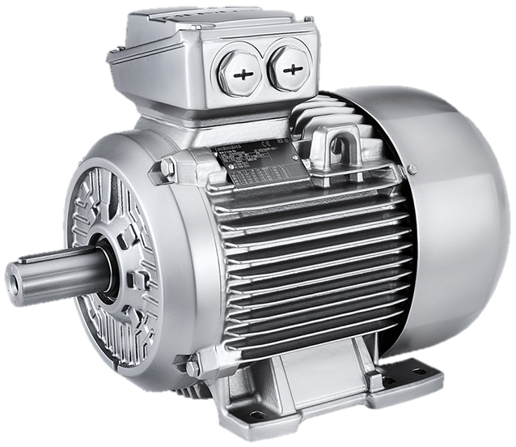
Electric Motor
A device changing electrical energy into mechanical energy is known as ELECTRIC MOTOR.
WORKING PRINCIPLE :
Force is exerted on a current carrying conductor placed in a magnetic field

Slide 6

Electric/DC Motor
Iron core
C
C
C
C
C
C
C
C
C
C
C
C
B
C
B
B
B
B
B
B
B
B
B
B
B
B
Armature
coil
N
S
A
D
A
D
A
A
A
A
A
A
A
A
A
A
A
D
D
D
D
D
D
D
D
D
D
D
Split ring
commutator
R₁
Brushes
R₁
R₁
R₁
R₁
R₁
R₁
R₁
R₁
R₁
R₁
R₁
R₁
R₂
R₂
R₂
R₂
R₂
R₂
R₂
R₂
R₂
R₂
R₂
R₂
R₂
B₁
B₁
B₂
B₂
)
(
–
+
Battery
K

Slide 7
Drawing of DC Motor
Armature coil
B
C
N
S
A
D
Carbon Brushes
(B! and B₂)
Split rings
(R₁ and R₂)
E
F
Axle
.
+
–
K
( )

Slide 8
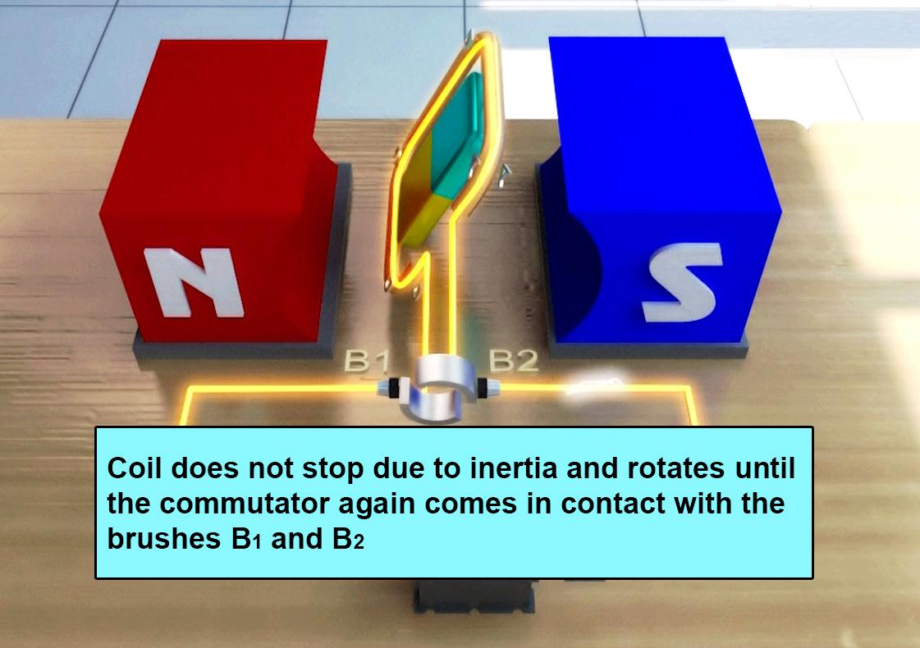
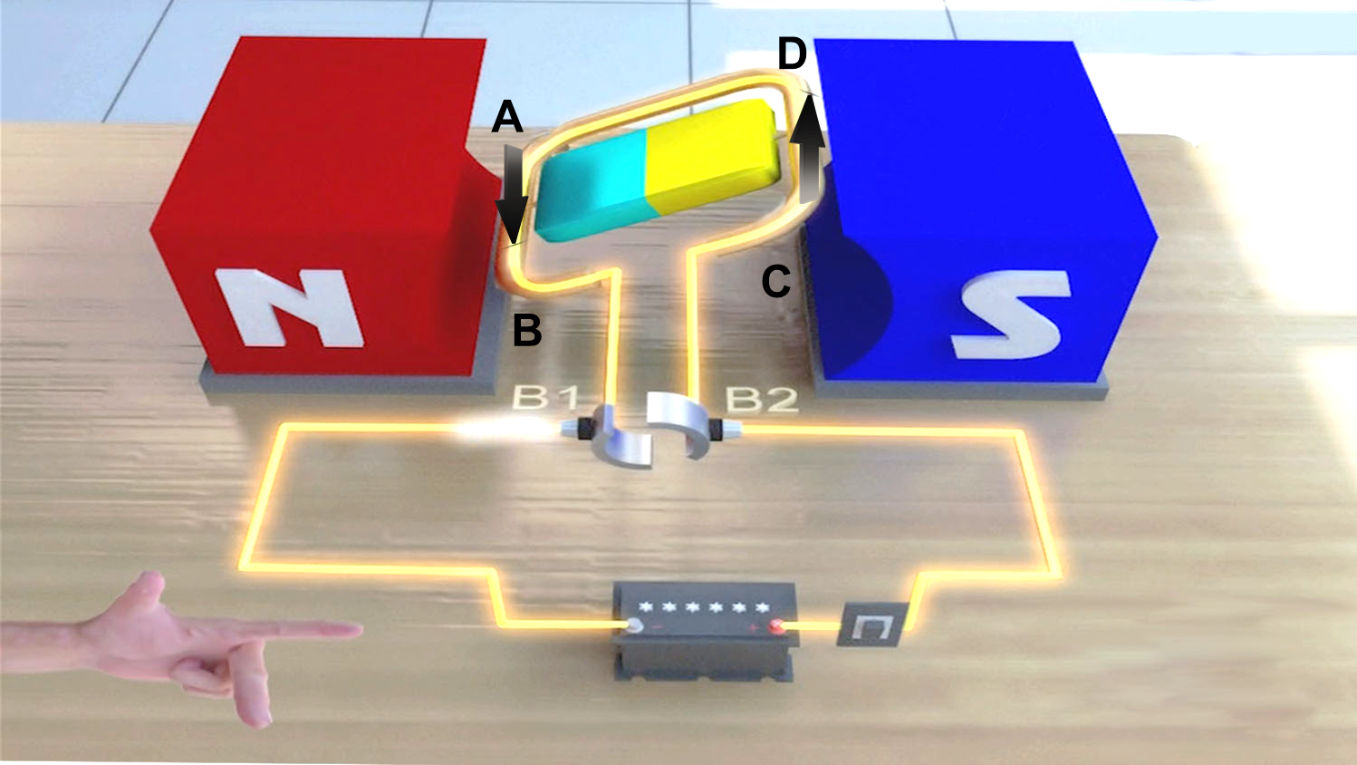
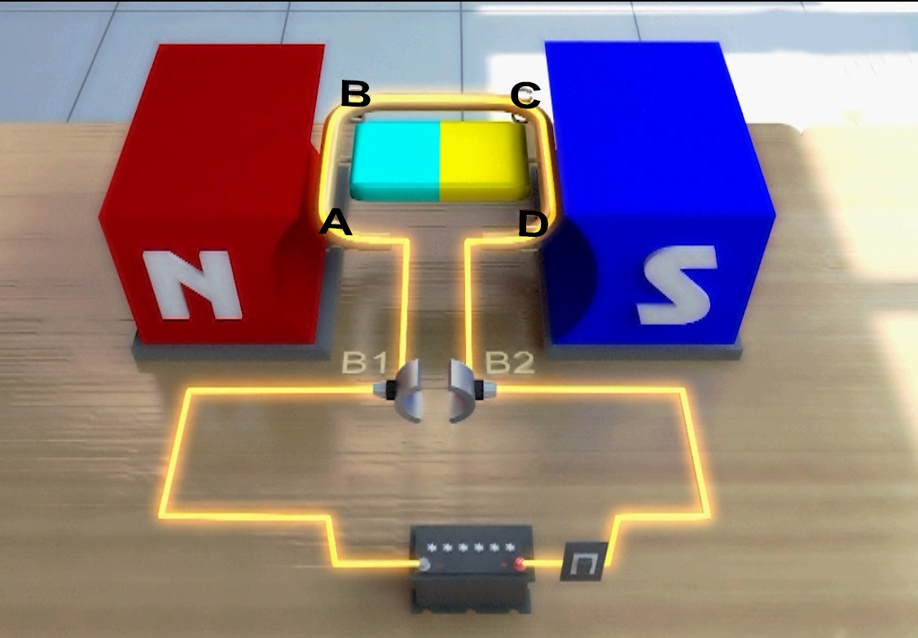
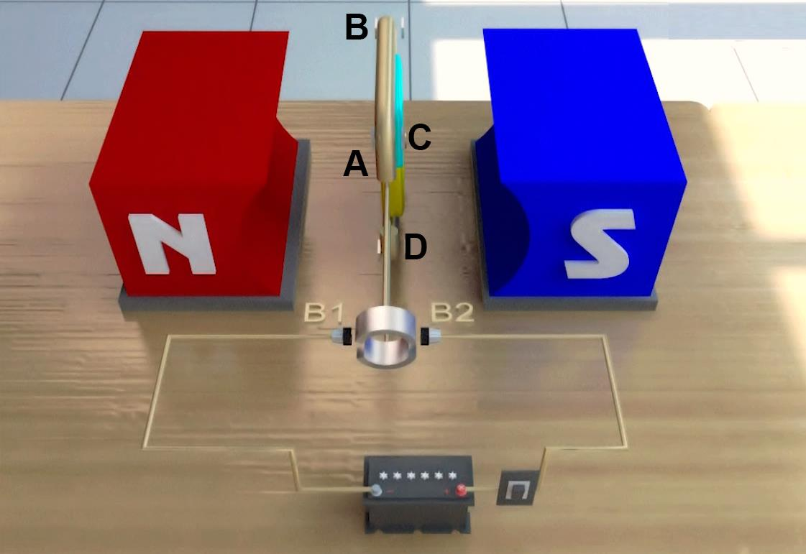
Electric Motor
– Working of the electric motor:
B
C
AB – downwards
CD - upwards
Vertical-contact
breaks
S
Current - ABCD
N
The loop and the axle continue to rotate in the anticlockwise
direction
D
The current in the loop is reversed after each half rotation
A
Carbon Brushes
(B₁ and B₂)
Split rings
(R₁ and R₂)
Inertia
VIDEO
E
F
Axle
.
+
–
K
( )

Slide 9
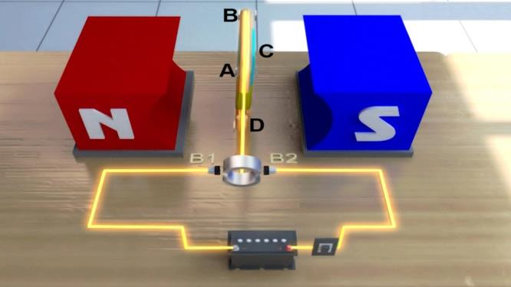
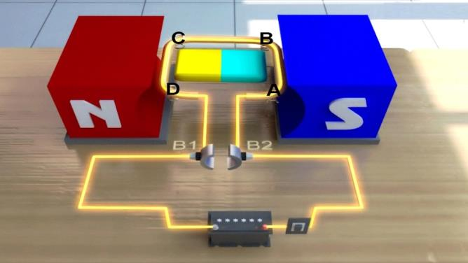
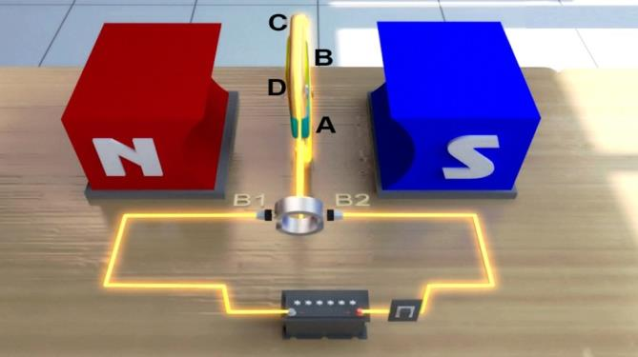
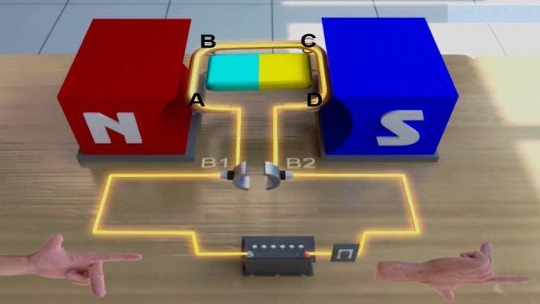
90°
180°
270°
360°

Slide 10
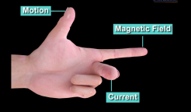
1. In the first half cycle, current flows in the armature coil along A-B-C-D
2. Arms AB and CD experience a force
3. Direction of force can be found using Flemings left hand rule
4. Arm AB moves downward and CD moves upward
5. The armature coil rotates in the anticlockwise direction.
6. In the next half cycle, arms AB and CD exchange their positions and current flows in the armature coil along D-C-B-A
7. Arm CD moves downward and AB moves upward
8. The armature coil continues to rotate in the anticlockwise direction.
9. The split ring commutator reverses the direction of current every half cycle.

Slide 11

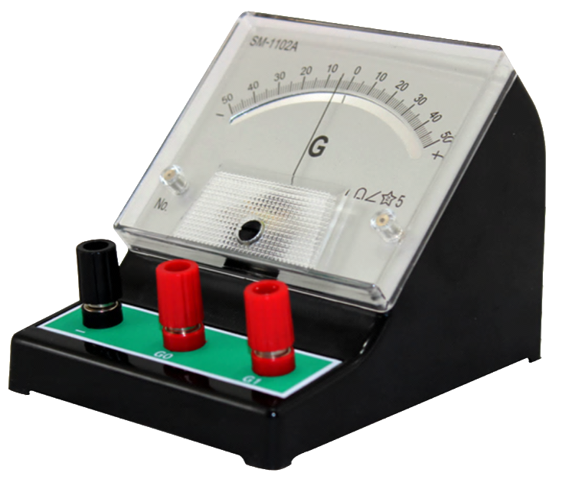
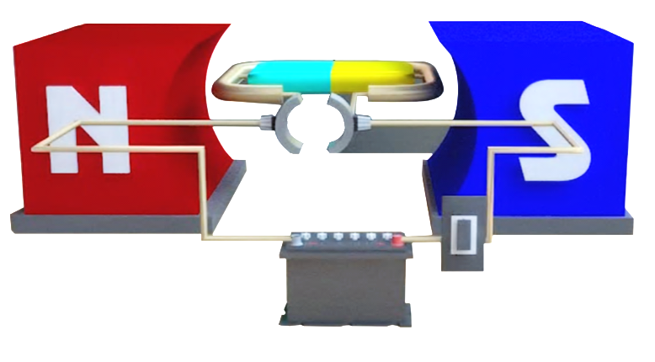
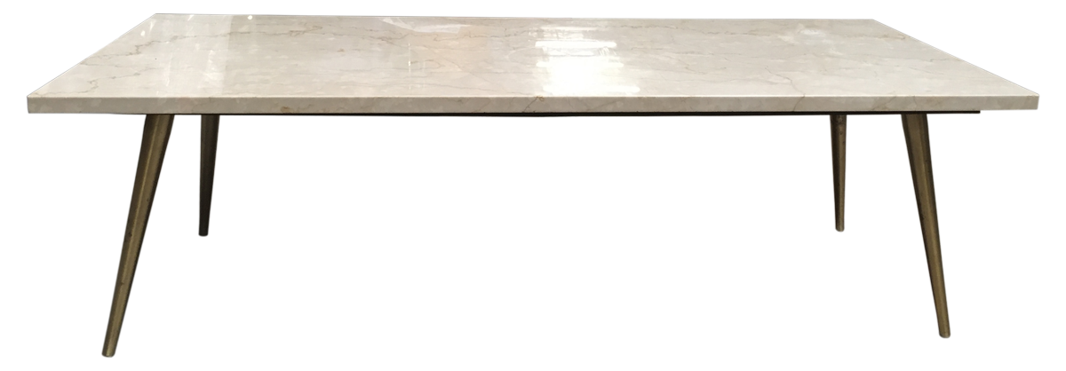
Galvanometer
Galvanometer is simply a motor with a needle

Slide 12

ANSWER
Q.
When will the induced current in the electrical conductor (coil) be maximum?
Ans :
It will be maximum when the direction of motion of the electric conductor is perpendicular to the magnetic field.
Q.
When will the induced current in the electrical conductor (coil) be minimum?
Ans :
It will be minimum when the direction of motion of the electric conductor is parallel to the magnetic field.

Slide 13


A current carrying straight conductor is placed in east-west direction. What will the direction of the force experienced by this conductor due to earth’s magnetic field? How will this force get affected on:
reversing the direction of flow of current?
doubling the magnitude of current?
Q.
Ans.
The direction of earth’s magnetic field is from geographical south to geographical north. According to Fleming’s left hand rule, the current carrying straight conductor placed in east-west direction will be deflected downwards.
On reversing the direction, the conductor is deflected in the upward direction.
If the magnitude of current is doubled, it will result in doubling the magnitude of force.

Slide 14
An electron enters a uniform magnetic field at right angles to it as shown in Fig. In which direction will this electron move? State the principle applied by you in finding the direction of motion of the electron.
Q.
Ans.
The electron will move normally outward.
Fleming’s left hand rule: Stretch the forefinger, the central finger and the thumb of the left hand mutually perpendicular to each other. If the forefinger points in the direction of the magnetic field, the central finger in the direction of current, then the thumb points in the direction of force on the conductor.
Electron
Magnetic
Field

Slide 15
Which of the following property of a proton can change while it moves freely in a magnetic field? (There may be more than one correct answer.)
(a) mass (b) speed
(c) velocity (d) momentum
Q.
Ans.
The correct option are (c) and (d). The magnetic force acts perpendicular to the direction of motion of the proton. It does not change its mass and speed but changes its direction of motion. So both velocity and momentum get changed.

Slide 16
A positively-charged particle (alpha-particle) projected towards west is deflected towards north by a magnetic field. The direction of magnetic field is
towards south (b) towards east
(c) downward (d) upward
Q.
Ans.
The correct option is (d). This is in accordance with Fleming’s left hand rule.

Slide 17
Imagine that you are sitting in a chamber with your back to one wall. An electron beam, moving horizontally from back wall towards the front wall, is deflected by a strong magnetic field to your right side. What is the direction of magnetic field?
Q.
Ans.
According to Fleming’s left hand rule, the magnetic field acts in the vertically downward direction. Note that the direction of current will be opposite to that of the electron beam.

Slide 18
Thank You

